Slide 1
Unit 6
CODING PRACTICES AND PROGRAMMING
Hours: 4 hours
Presented by
Er.Harendra Bikram Shah (Lecturer)
Department of BCA NAST

Slide 2
OUTLINES
Programming Languages and Development Tools
Selecting programming languages and tools for software development.
Best Practices in Coding
Clean code practices, code readability, and refactoring.
Introduction to software development environments and integrated development environments (IDEs).

Slide 3
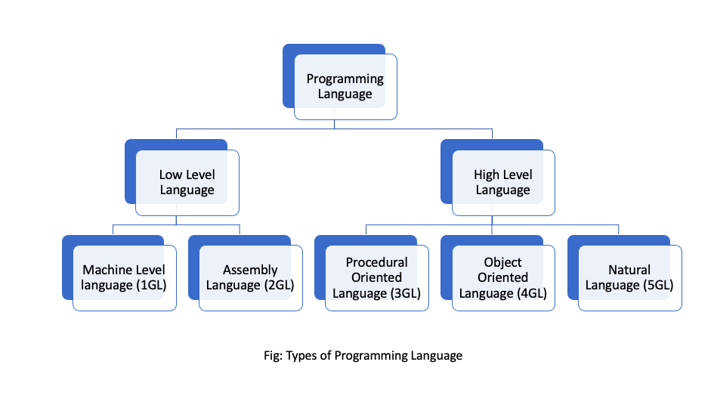
PROGRAMMING LANGUAGES AND DEVELOPMENT TOOLS

Slide 4
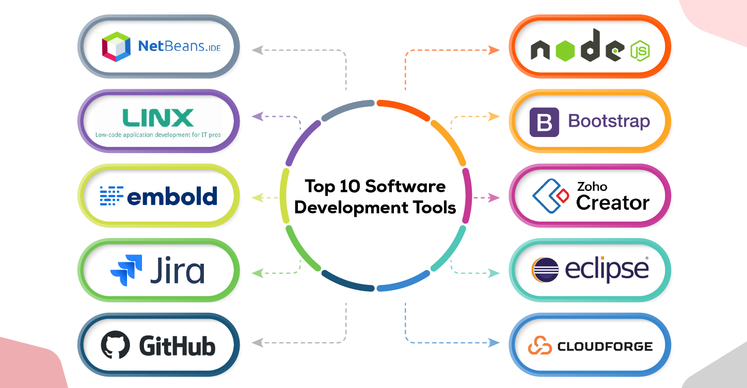
DEVELOPMENT TOOLS

Slide 5
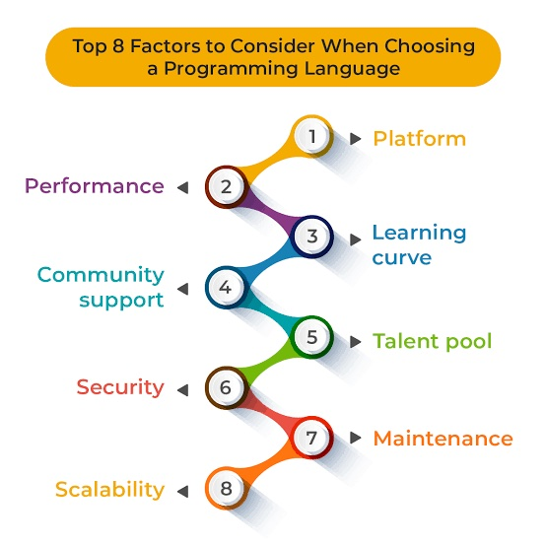
SELECTING PROGRAMMING LANGUAGES AND TOOLS FOR SOFTWARE DEVELOPMENT.

Slide 6
SELECTING PROGRAMMING LANGUAGES AND TOOLS FOR SOFTWARE DEVELOPMENT.
Language | Primary Use Case | Strengths
Python | AI/ML, Web Dev, Scripting | Easy syntax, vast libraries
JavaScript | Web Frontend/Backend (Node.js) | Universal in browsers
Java | Enterprise, Android | Strong typing, JVM ecosystem
C++ | Game Dev, Embedded Systems | High performance
Go (Golang) | Cloud Services, CLI Tools | Fast compilation, concurrency

Slide 7
TOOLS FOR SOFTWARE DEVELOPMENT
Development Phase | Recommended Tools
Coding | VS Code, IntelliJ, PyCharm
Version Control | Git, GitHub, GitLab
Dependency Management | npm, pip, Maven
Testing | Jest, pytest, Selenium
Deployment | Docker, Kubernetes

Slide 8
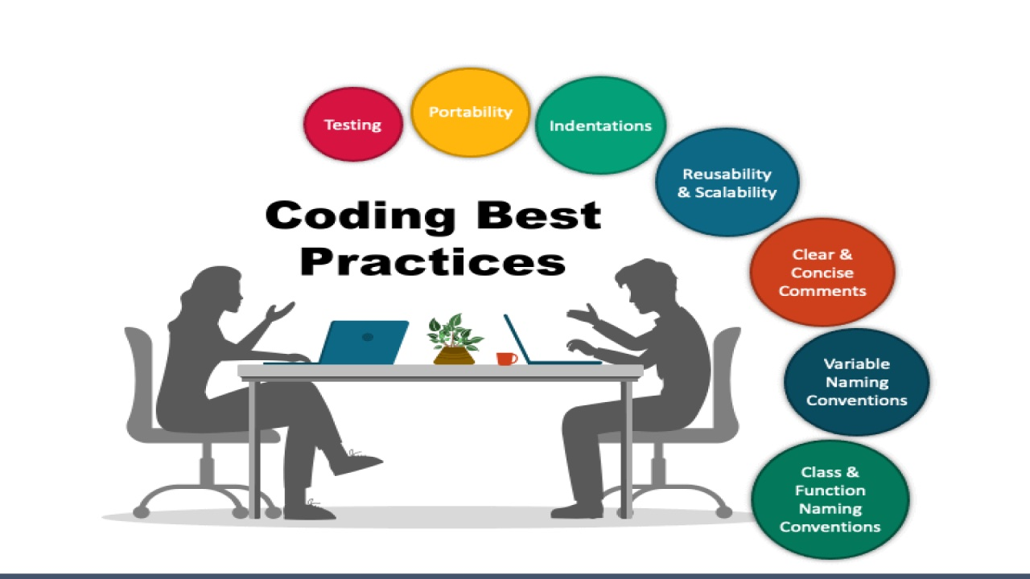
TOOLS FOR SOFTWARE DEVELOPMENT

Slide 9
CLEAN CODE PRACTICES, CODE READABILITY, AND REFACTORING
Clean code is a term used to refer to code that is easy to read, understand, and maintain
Importance
Readability and maintenance:
Team collaboration:
Debugging and issue resolution:
Improved quality and reliability:
Principles of Clean Code
Avoid Hard-Coded Numbers
Use Meaningful and Descriptive Names
Use Comments Sparingly, and When You Do, Make Them Meaningful
Write Short Functions That Only Do One Thing
Follow the DRY (Don't Repeat Yourself) Principle and Avoid Duplicating Code or Logic
Follow Established Code-Writing Standards
Encapsulate Nested Conditionals into Functions
Refactor Continuously
Use Version Control

Slide 10
CODE READABILITY
Refers to how easily a human reader can understand the purpose, logic, and structure of source code
Why is code readability important?
Maintainability:
Collaboration:
Reduced Bugs:
Faster Development:
Improved Code Quality:
How to improve code readability:
Meaningful Names:
Consistent Style:
Comments:
Code Structure:
Code Reviews:
Adhere to Standards:
Follow Refactor:

Slide 11
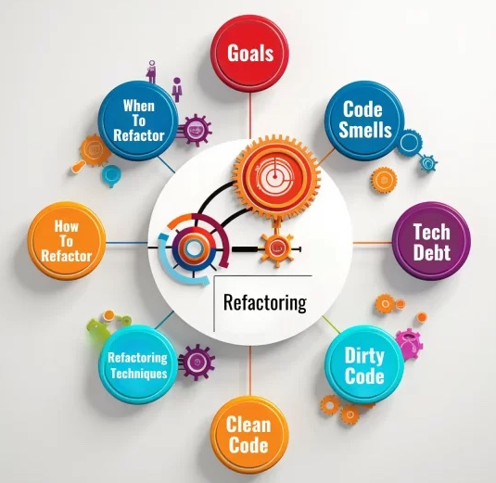
REFACTORING
systematic and disciplined process of improving the internal structure of code without altering its external behavior.
Objectives/Goals of Refactoring
Enhance Code Quality
Reduce Complexity:
Remove Redundancies:
Optimize Performance:
Uncover and Rectify Bugs:

Slide 12
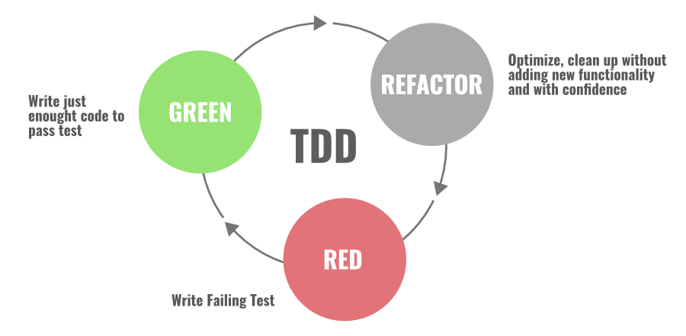
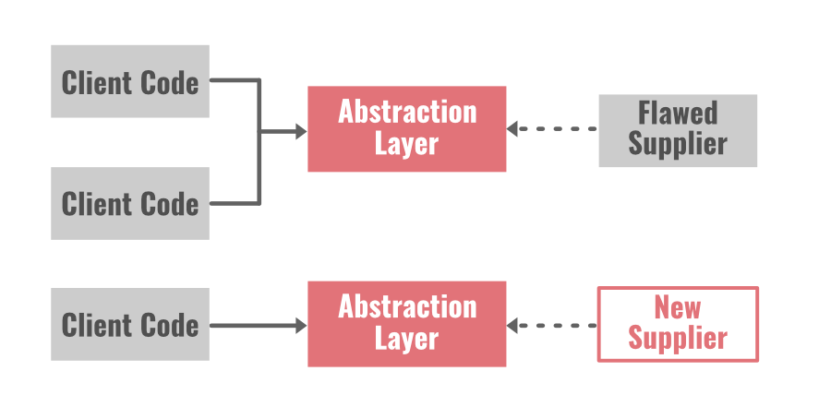
MOST COMMON CODE REFACTORING TECHNIQUES
1. Red-Green Refactoring
2. Refactoring By Abstraction

Slide 13
MOST COMMON CODE REFACTORING TECHNIQUES
3. Composing Method
we use streamline methods to reduce duplication in our code.
4. Simplifying Methods
There are two techniques involved in this approach.
Simplifying Conditional Expressions Refactoring: Conditional statement in programming becomes more logical and complicated over time
Simplifying Method Calls Refactoring: In this approach, we make method calls simpler and easier to understand.
5. Moving Features Between Objects: In this technique, we create new classes, and we move the functionality safely between old and new classes.

Slide 14
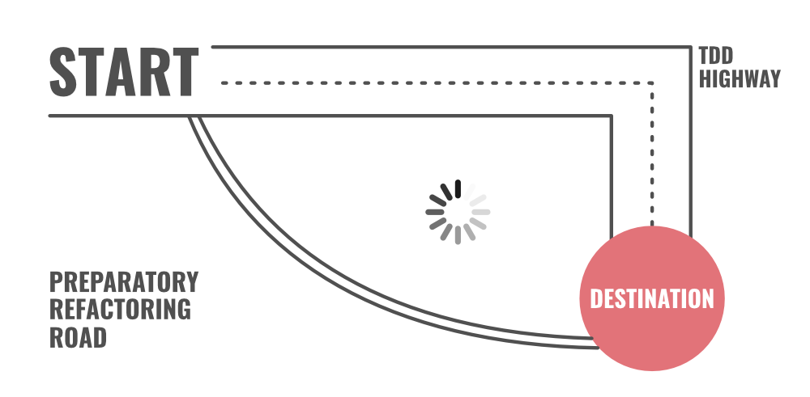
MOST COMMON CODE REFACTORING TECHNIQUES
6. Preparatory Refactoring
7. User Interface Refactoring
make simple changes in UI and refactor the code. For example: align entry field, apply font, reword in active voice indicate the format, apply common button size, and increase color contrast, etc.

Slide 15
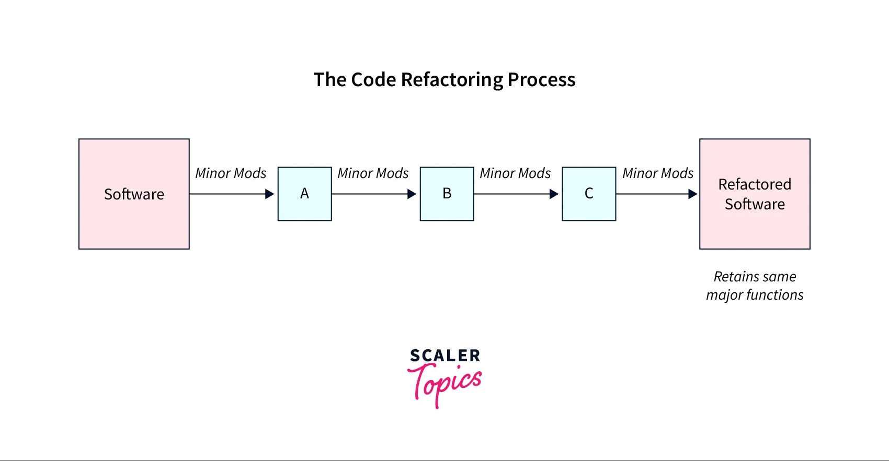
CODE REFACTORING PROCESS

Slide 16
INTRODUCTION TO SOFTWARE DEVELOPMENT ENVIRONMENTS AND INTEGRATED DEVELOPMENT ENVIRONMENTS (IDES).
A Software Development Environment (SDE) refers to the complete set of tools, processes, and infrastructure used by developers to create, test, debug, and maintain software applications.
Components of a Software Development Environment:
Operating System:
Programming Language Compilers/Interpreters:
Build Tools: Automate the process of compiling and linking code (e.g., Maven, Gradle, Make).
Version Control Systems: Tools to track changes and collaborate (e.g., Git).
Testing Frameworks: Automate testing to ensure code quality (e.g., JUnit, Selenium).
Debuggers: Tools to find and fix bugs (e.g., GDB, WinDbg).
Libraries & Frameworks: Reusable code components (e.g., .NET, React, TensorFlow).
Databases: For storing and retrieving application data (e.g., MySQL, MongoDB).
Documentation Tools: Help document the system (e.g., Doxygen, Javadoc).

Slide 17
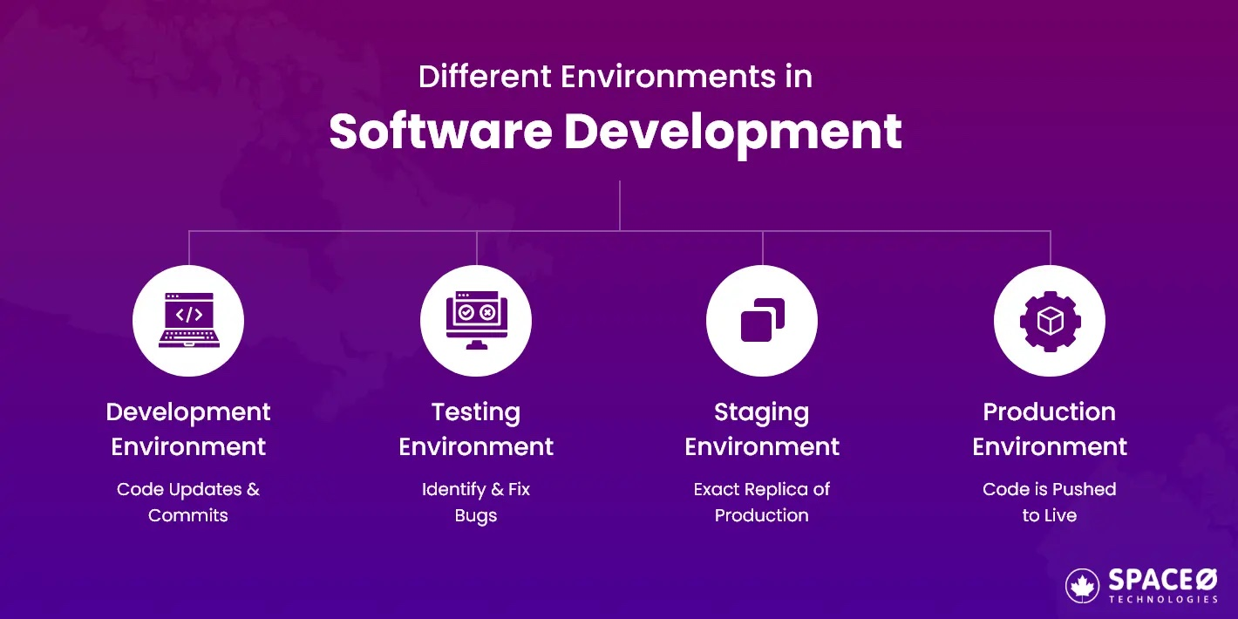
INTRODUCTION TO SOFTWARE DEVELOPMENT ENVIRONMENTS AND INTEGRATED DEVELOPMENT ENVIRONMENTS (IDES).

Slide 18
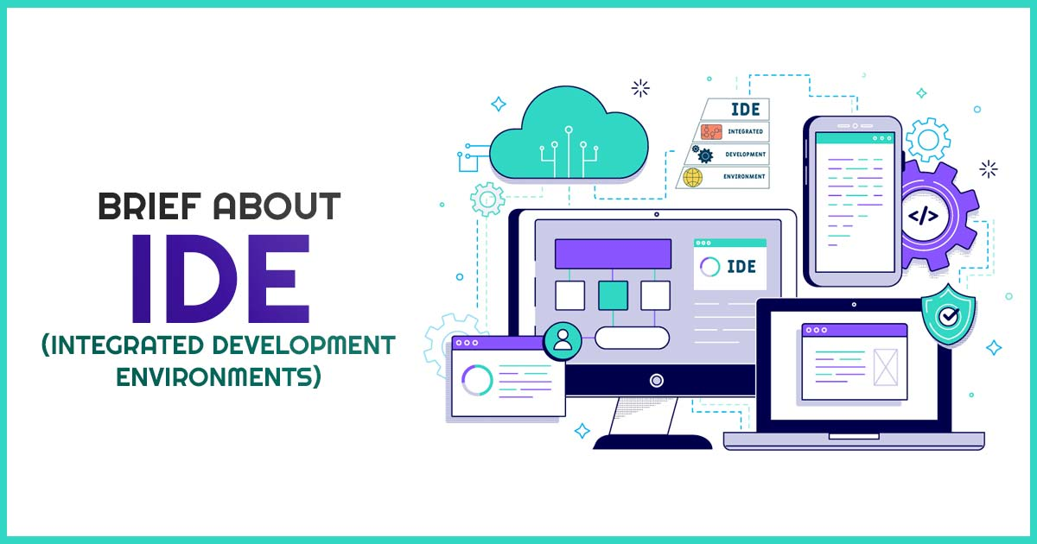
INTEGRATED DEVELOPMENT ENVIRONMENTS (IDES).
A software app that offers complete features for software development.
A source code editor, build automation tools, and a debugger is typically included in an IDE.
Key Features of IDEs:
Code Editor: Syntax highlighting, auto-completion, and error detection.
Compiler/Interpreter Integration: Directly compile or run code.
Debugger: Set breakpoints, inspect variables, and step through code.
Build Automation Tools: Integration with tools like Gradle or Maven.
Project/File Management: Organize and manage project files easily.
Version Control Integration: Git integration within the IDE.
GUI Design Tools: Visual tools for UI/UX development (e.g., Android Studio).
Plugin Support: Add new tools/features (e.g., ESLint, Docker plugins).
Terminal Access: Built-in terminal for CLI-based operations.

Slide 19
INTEGRATED DEVELOPMENT ENVIRONMENTS (IDES).
IDE | Best For | Languages
Visual Studio Code | Lightweight & extensible | JavaScript, Python, C++, etc.
IntelliJ IDEA | Enterprise Java development | Java, Kotlin
Eclipse | Versatile open-source IDE | Java, C++, PHP
PyCharm | Python programming | Python
NetBeans | General purpose | Java, PHP, C++
Android Studio | Android app development | Java, Kotlin
Xcode | Apple ecosystem | Swift, Objective-C

Slide 20
End of the Unit

Slide 21
THANK YOU

